Slide 1

HR ANALYTICS
Dang dai duong
Mentorship program 2024

Slide 2
HR ANALYTICS
DESIGN DATABASE

Slide 3
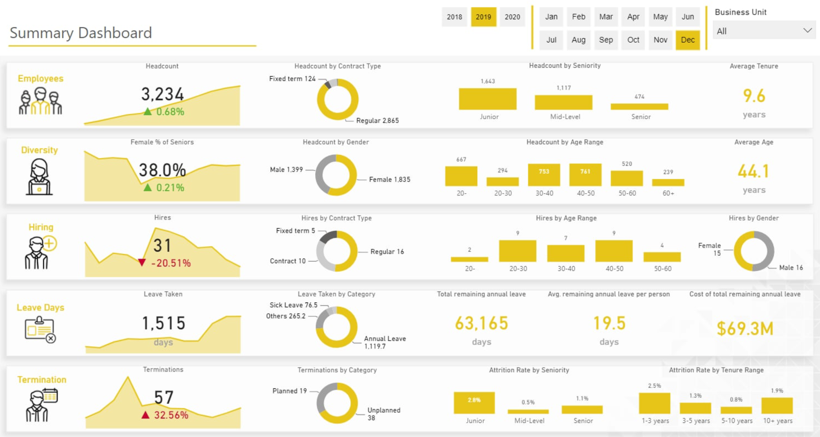

Slide 4
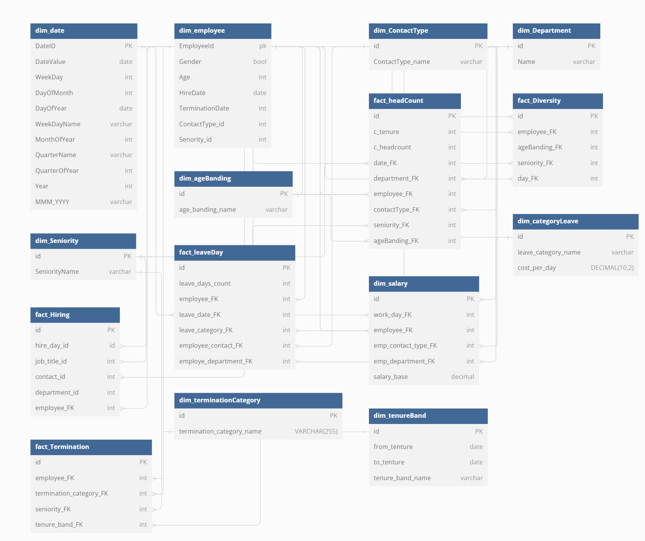
GENERAL DATABASE

Slide 5
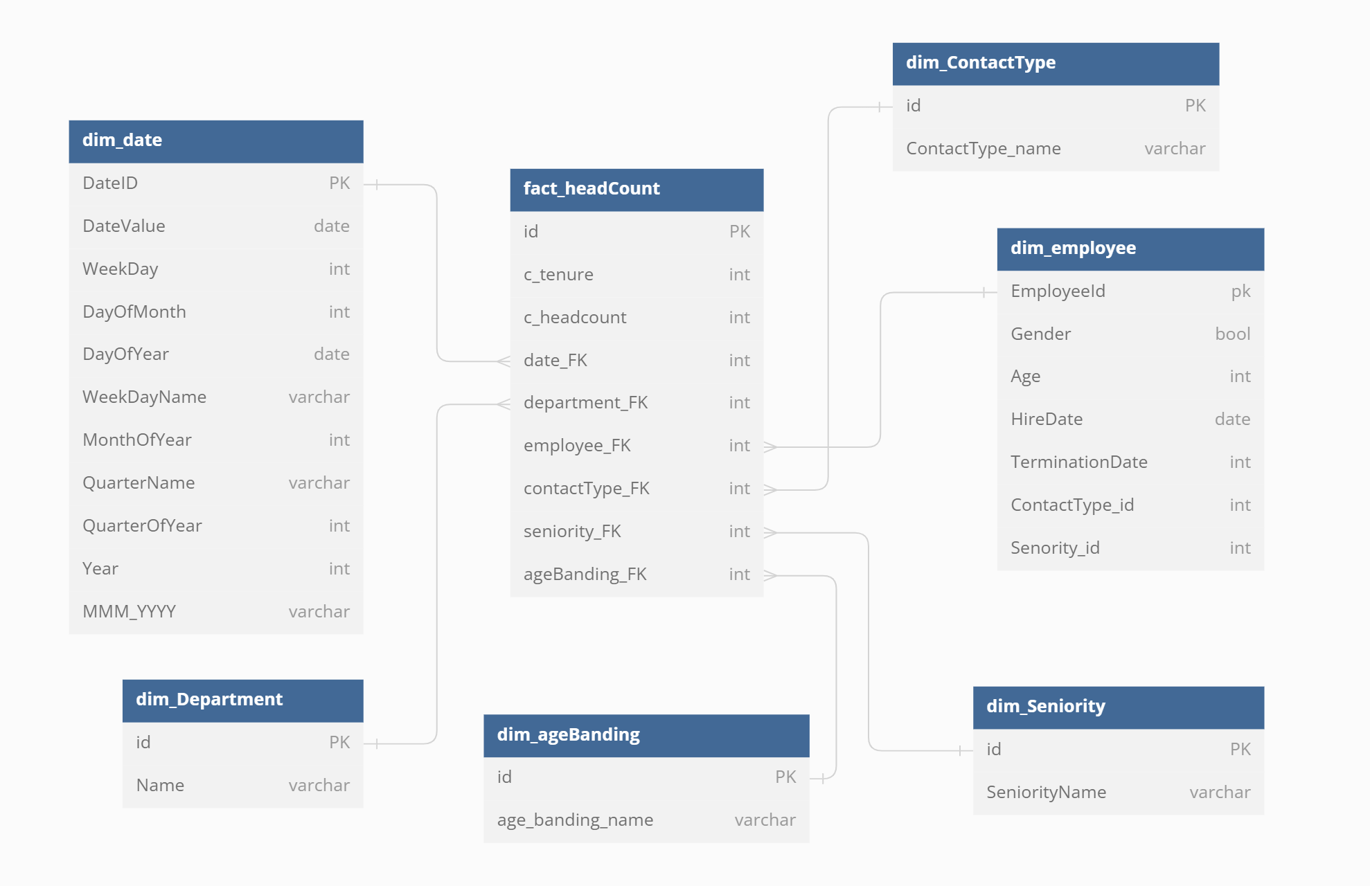

Slide 6
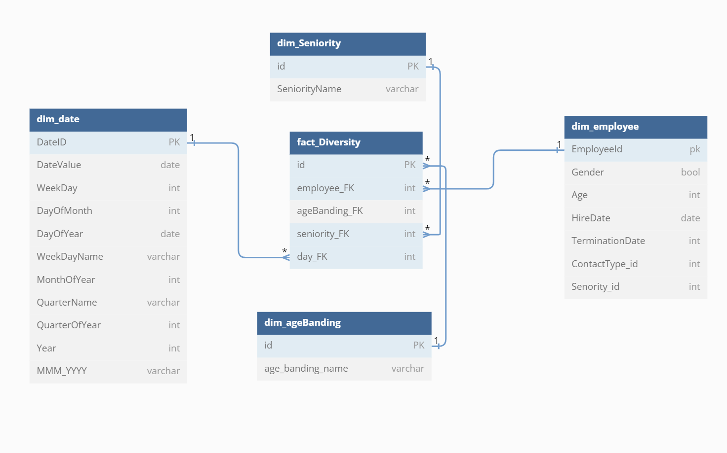

Slide 7
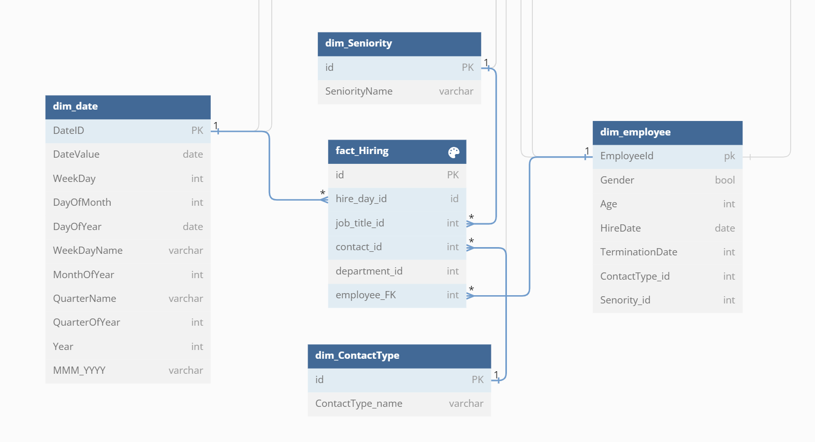

Slide 8
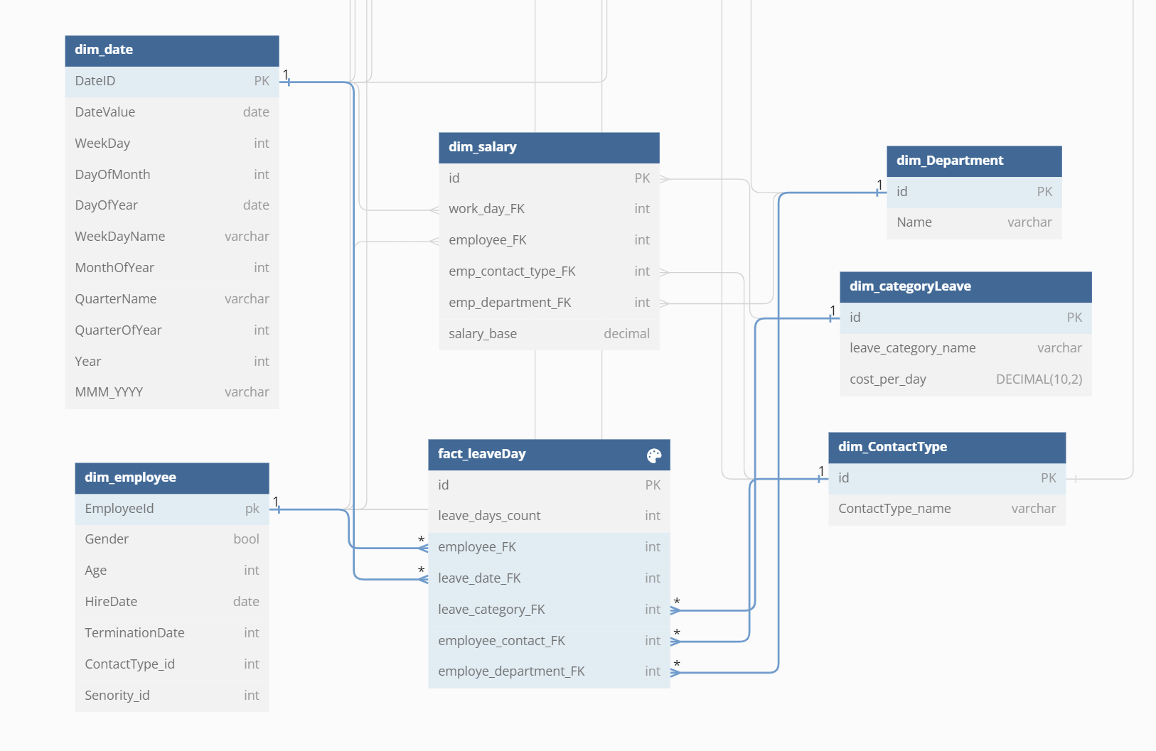

Slide 9
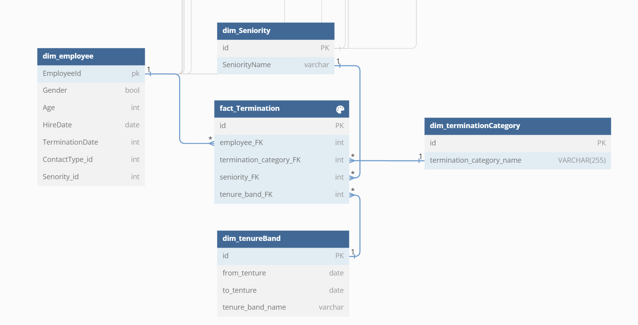

Slide 10
THANKS FOR LISTENING

